Slide 1

Open Banking Case Study: Plaid
A pipeline connecting new and old finance
By Marc Weimer

Slide 2
Contents
Overview and Origin
Business Activities
Results and Landscape
Recommendations

Slide 3

Overview and Origin
FinTech companies want:
Access to customer data, financial history, money transfers
Universal client experience
Challenges to a seemingly simple problem:
Checking account still the center of a US consumer financial life
5,000 different banks in the US
Banks have varying levels of technical capability and security requirements
Calling the plumber
Plaid connects FinTech and Bank systems
Founded in 2012
$300mm capital raised, valued at estimated $2 billion

Slide 4

Business Activities
Plaid focused on consumer facing platforms
Partner with Banks (sometimes) for secure transfer of data
FinTech provider is the paying customer
Most consumers completely unaware they interact with Plaid
Technology stack:
API
Screen and web data scraping
Database management (MySQL, Mando DB)
Java for web integration
Data visualization

Slide 5
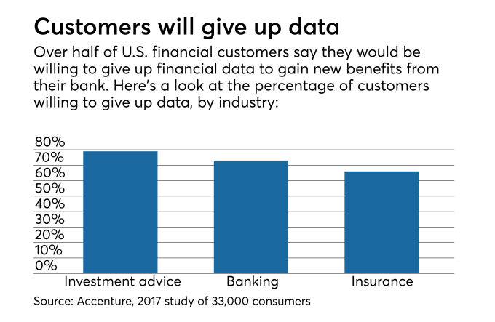

Results and Landscape
2018 – 1 of 4 US consumers used Plaid
Thousands of banks accessible
Consumers expect free access to their data, but lingering sentiment that bank should act as guardian
Open banking strategies all under review at every major bank in the US
Clashes with titans: Capital One 2018

Slide 6

Recommendations
Go Global
Consumer lives expanding beyond US borders
Open banking regulations in Europe, ripe market
China and disintermediating banking
Go up market
Small Business Expansion
Global corporate expansion
Bank relationship management (can you bite the hand that feeds you your data)?

Slide 7
References
Accenture. (2019, July). THE FUTURE OF FINTECH AND BANKING: DIGITALLY DISRUPTED OR REIMAGINED? Retrieved from Accenture: https://www.accenture.com/us-en/insight-future-fintech-banking
DiCamillo, N. (2018, July 17). In data dispute with Capital One, Plaid stands alone. Retrieved from American Banker: https://www.americanbanker.com/news/in-data-dispute-with-capital-one-plaid-stands-alone
Konrad, A. (2018, December 11). Fintech Startup Plaid Is Now Valued At $2.65 Billion After $250 Million Raise. Retrieved from Forbes: https://www.forbes.com/sites/alexkonrad/2018/12/11/mary-meekers-first-post-kleiner-deal-fintech-startup-plaid-now-valued-at-265-billion/#2545290677d6
Laura Brodsky, C. I. (2018, August). Open banking’s next wave: Perspectives from three fintech CEOs. Retrieved from McKinsey: https://www.mckinsey.com/industries/financial-services/our-insights/open-bankings-next-wave-perspectives-from-three-fintech-ceos
Plaid. (2019, August). Plaid. Retrieved from Plaid: https://plaid.com/
StackShare, Inc. (2019, August). Plaid Stack. Retrieved from Stackshare: https://stackshare.io/plaid/plaid
Stack. Retrieved from Stackshare: https://stackshare.io/plaid/plaid

